Slide 1

SmartDent-AI: AI-Driven Diagnosis and Treatment Solutions
Group No. 1
Project Guide
Mr. Vaibhav Yavalkar & Ms. Aishwarya Londhe
Group Member | Moodle ID
Ekta Panchal | 21107049
Aryan Palaspagar | 21107040
Janvi Sharma | 21107032
Swapnil Rathod | 21107064
Notes:
1

Slide 2
Contents
Abstract
Introduction
Objectives
Literature Review
Research Gap
Problem Definition
Scope
Technological Stack
Proposed System Architecture/Working
Prototype Design Demonstration
Implementation Status
Review Suggestions
Notes:
2

Slide 3
Abstract
SmartDent-AI is an advanced dental diagnostic and care platform designed to address key challenges in dental practice, such as accurate diagnosis, treatment planning, and patient engagement. The system leverages Artificial Intelligence (AI) to transform traditional dental practices. Using deep learning algorithms, including Convolutional Neural Networks (CNNs) models, SmartDent-AI analyzes dental X-rays and intraoral images to detect issues such as calculus, dental caries, mouth ulcers, gingivitis, tooth discoloration, and teeth misalignment. It also provides detailed treatment simulations for orthodontic procedures, improving precision and patient communication.
Additionally, the platform offers remote consultations through telemedicine tools, allowing patients to upload images for AI-driven diagnostics and receive personalized treatment recommendations. SmartDent-AI supports specialist appointment bookings, manages patient records securely, and offers real-time progress monitoring, providing a comprehensive solution to enhance dental diagnostics and care.
Notes:
3

Slide 4
Introduction
Dental health plays a vital role in overall well-being, yet the field of dentistry faces challenges in providing accurate, timely, and accessible care to patients. Traditional diagnostic methods often rely on manual inspection of dental X-rays and intraoral images, which can be prone to human error. Moreover, access to specialized dental care is limited in remote areas, resulting in delayed treatments.
Motivation
Passion for Innovation: Driven to use AI and cutting-edge tech to improve healthcare and patient outcomes.
Problem-Solving: Motivated by the challenge of creating impactful solutions that enhance dental care accuracy and accessibility.
Real-World Impact: Motivated by the chance to apply AI solutions to solve practical healthcare problems and drive positive change in the dental industry.
Notes:
4

Slide 5
Objectives
To Enhance Diagnostic Precision: Utilize deep learning algorithms, including Convolutional Neural Networks (CNNs), to analyze dental images.
To Generate Orthodontic Treatment Simulations: Develop advanced treatment simulation capabilities for orthodontic procedures, enabling both patients and dentists to visualize potential outcomes and improve treatment planning.
To Implement Treatment Recommendations: To deploy Recommendation System to provide personalized treatment recommendations based on diagnostic data.
To Facilitate Remote Consultations: Integrate telemedicine platforms and secure video conferencing tools to enable patients to upload images and consult with dentists remotely, enhancing accessibility and convenience.
To Create Specialist Appointment Scheduling: Develop an integrated booking system that enables patients to schedule appointments with dental specialists based on AI-generated diagnostic reports, utilizing a user-friendly web interface.
Notes:
5

Slide 6
Literature Review
Sr.no | Title | Author(s) | Year | Methodology | Drawback
1. | Classification of Dental Cavities from X-ray images using Deep CNN algorithm | M. Muthu Lakshmi , Dr. P. Chitra | 2020 | Segmentation Technique, Feature Extraction, Deep CNN Classification | Limited performance in complex cases like overlapping teeth. May not generalize well for other dental diseases beyond cavities
2. | Teeth Detection and Dental Problem Classification in Panoramic X-Ray Images using Deep Learning and Image Processing Techniques | Mircea Paul Muresan, Andrei Rzvan Barbura, Sergiu Nedevschi | 2020 | ERFNet for semantic segmentation, image processing, Tooth Detection, Data Collection | Struggles with overlapping teeth. Computationally expensive, needs optimization
3. | Dental Caries early detection using Convolutional Neural Network for Tele dentistry | Devesh Saini, Richa Jain, Anita Thakur | 2021 | CNN models (Vgg16, Vgg19, InceptionV3, ResNet50) to detect dental caries from 500 images (with and without caries). Preprocessing, | Vgg models were slow and resource-heavy. Limited dataset size (500 images) affects generalizability
4. | CVApool: using null-space of CNN weights for the tooth disease classification | Zuhal Can, Sahin Isik, Yildiray Anagun | 2024 | Used pre-trained CNN models (EfficientNetB1, B2, B3, V2S) with CVApool. | Risk of overfitting in complex models.

Slide 7
Literature Review
Sr.no | Title | Author(s) | Year | Methodology | Drawback
5. | 2D to 3D Evolutionary Deep Convolutional Neural Networks for Medical Image Segmentation | Tahereh Hassanzadeh, Daryl Essam, Ruhul Sarker | 2020 | U-Net architecture, Converts optimized 2D networks, Adapts 2D operations (convolution, pooling) to 3D networks | High computational cost, Limited generalization, time-consuming
6. | A Fully Automated Method for 3D Individual Tooth Identification and Segmentation in Dental CBCT | Tae Jun Jang , Kang Cheol Kim , Hyun Cheol Cho , and Jin Keun Seo | 2022 | Multi-step deep learning model, Teeth detection and segmentation, 3D ROIs (loose and tight) | Metal artifacts impact segmentation accuracy. High-dimensional data poses challenges. Tight ROIs may cut off parts of teeth.
7. | 3D Structure-guided Network for Tooth Alignment in 2D Photograph | Yulong Dou, Lanzhuju Mei,Dinggang Shen, Zhiming Cui | 2023 | Segmentation (Segm-Mod) using U-net. Alignment (Align-Mod) using Diffusion, Generation (Gen-Mod) | Does not account for occlusal relationships. No 3D reconstruction from 2D images, limiting detailed orthodontic applications

Slide 8
Literature Review
Sr.no | Title | Author(s) | Year | Methodology | Drawback
8. | A smart home dental care system: integration of deep learning, image sensors, and mobile controller | Dogun Kim, Jaeho Choi, Sangyoon Ahn, Eunil Park | 2021 | RetinaNet detects teeth regions. ResNeXt classifies tooth diseases and need for professional treatment (NPDT). | Small Dataset, Individual user traits not considered in the model
9. | Automatic Segmentation of Individual Tooth in Dental CBCT Images From Tooth Surface Map by a Multi-Task FCN | Yanlin Chen, Haiyan Du, Zhaoqiang Yun. | 2020 | Two-Branch Fully Convolutional Network (FCN) predicts tooth region and surface probability maps. Thresholding creates a mask to separate foreground (tooth) from background. | Limited Dataset: Only 25 CBCT images were used, limiting generalizability.
10. | Anatomically Constrained Deep Learning for Automating Dental CBCT Segmentation and Lesion Detection | Zhiyang Zheng, Katherine J. Shi, Mel Mupparapu, and Jing Li | 2020 | Dense U-Net, CBCT Segmentation, Lesion Detection, Deep Learning, Dental Imaging, Variational Inference. | Manual Segmentation, Small Dataset, Limited Anatomical Knowledge
11. | Artificial intelligence in medico-dental diagnostics of the face: a narrative review of opportunities and challenges | Raphael Patcas, Michael M. Bornstein | 2022 | Focus on ANN, using deep learning for medical image analysis. | Need for large, diverse datasets, privacy concerns, and a lack of standardized evaluation criteria

Slide 9
Literature Review
Sr.no | Title | Author(s) | Year | Methodology | Drawback
12. | A Review of Machine Learning Methodologies for Dental Disease Detection | Gautam Chitnis, Vidhi Bhanushali, Aayush Ranade | 2020 | CNN and Mask R-CNN for dental disease detection. Transfer learning and fine-tuning | Small datasets limit model performance. Accuracy below clinical standards
13. | UNet Architecture Based Dental Panoramic Image Segmentation | S. Sivagami, P. Chitra, G. Sri Ram Kailash, S.R. Muralidharan | 2020 | Combines contraction and expansion paths with skip connections. | Focuses only on panoramic X-rays.
14. | CariesNet: a deep learning approach for segmentation of multi-stage caries lesion from oral panoramic X-ray image | Haihua Zhu, Zheng Cao, Luya Lian1, Guanchen Ye | 2022 | CariesNet (U-shape network) with full-scale axial attention (FSAA) for caries segmentation. FSAA improves boundary detection for caries lesions. | Difficulty in accurately segmenting moderate caries due to blurred boundaries. Time-consuming data collection and annotation.
15. | Transfer learning: a friendly introduction | Asmaul Hosna, Ethel Merry, Jigmey Gyalmo, Zulfikar Alom | 2022 | Sample selection, domain adaptation, and kernel mean matching. It reuses knowledge from a source task to improve a target task. | Negative transfer can harm performance if tasks/domains are unrelated.2. Sample selection bias may lead to inaccurate models.

Slide 10
Research Gap(Limitations of existing systems)
Inadequate Accuracy: Current systems struggle with accurate prediction of orthodontic treatment outcomes.
Poor Integration: Existing systems often do not integrate well with existing orthodontic workflows.
Manual Segmentation: Existing methods rely heavily on manual segmentation, which is time-consuming.
Inefficient for Complex Structures: Conventional approaches struggle with cases involving complex dental structures, such as overlapping or touching teeth, especially in closed bite conditions.
Limited Automation: Most traditional methods require significant user input and do not provide fully automated, accurate segmentation of individual teeth.
Inadequate for Multiradicular Teeth: Techniques like template-based fitting and graph cut methods show poor performance with multiradicular teeth.
Boundary Blurring Issues: Current systems often fail to clearly distinguish between neighboring teeth due to blurred boundaries, resulting in segmentation inaccuracies.
Notes:
10

Slide 11
Problem Definition
Manual Segmentation Challenges: Current methods for segmenting individual teeth in CBCT images are time-consuming, labor-intensive, and prone to human error.
Blurred Boundaries: Neighboring teeth often have unclear or overlapping boundaries, making segmentation difficult.
Similar Intensities: Teeth and surrounding bone structures have similar intensities, complicating the segmentation process.
Complex Bite Conditions: Segmentation is challenging when teeth are in non-open or closed bite positions.
Artifacts: The presence of metal restorations or other artifacts in images adds complexity to accurate tooth segmentation.
Need for Automation: An AI-based automatic method is required to improve accuracy, efficiency, and consistency in segmenting individual teeth for diagnostic and treatment purposes.

Slide 12
Scope
AI-Driven Diagnostics: Implement deep learning algorithms, including Convolutional Neural Networks (CNNs), to analyze dental images (X-rays, intraoral images, etc) for accurate detection of dental conditions.
Orthodontic Treatment Simulations: Utilize 3D modeling and rendering technologies to create simulations of orthodontic treatments, enabling visualization of potential outcomes for both patients and dentists.
Personalized Treatment Recommendations: Deploy Recommendation Systems to generate tailored treatment suggestions based on diagnostic data.
Remote Consultations: Integrate telemedicine and secure video conferencing tools to facilitate remote consultations, allowing patients to discuss their diagnostics and treatment options with dentists.
Appointment Scheduling: Develop an integrated booking system that allows patients to schedule appointments with dental specialists based on AI-generated diagnostic reports through a user-friendly interface.

Slide 13
Technological Stack
Frontend
1. HTML5, CSS3, JS, React
2. WebRTC
Backend & Database
1. Python (Flask)
2. MongoDB
AI-Models
1. CNN-Based Models
- MobileNetV2: Dental disease detection from images
- U-Net: Image segmentation for orthodontic simulations
- DenseNet201 : Pretrained on ImageNet
- InceptionV3: Feature extraction and preprocessing for orthodontic predictions.
Notes:
13

Slide 14
Technological Stack
Dental Radiography (X-ray Dataset)
1. Train (1076 images)
2. Test (74 images)
3.Validation (122 images)
Oral Disease Dataset
1. Calculus (1296 images)
2. Data Caries (2382 images)
3. Gingivitis (2349 images)
4. Tooth Discoloration (1834 images)
5. Mouth Ulcer (2541 images)
Notes:
14

Slide 15
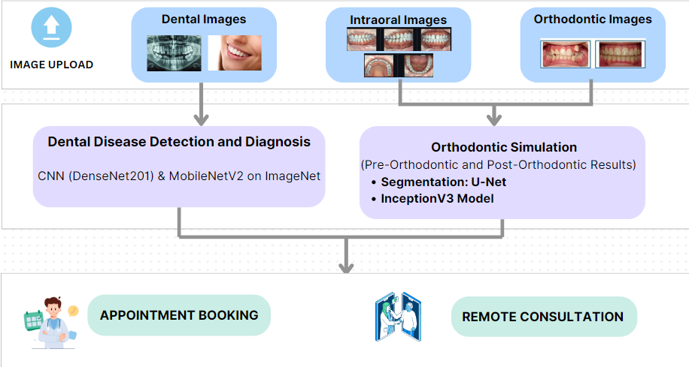
Proposed system architecture
Notes:
15

Slide 16
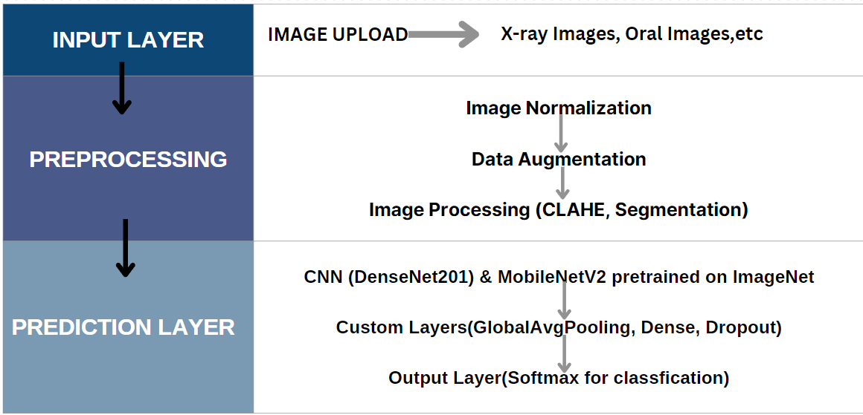
Dental Disease Detection & Diagnosis Working
Notes:
16

Slide 17
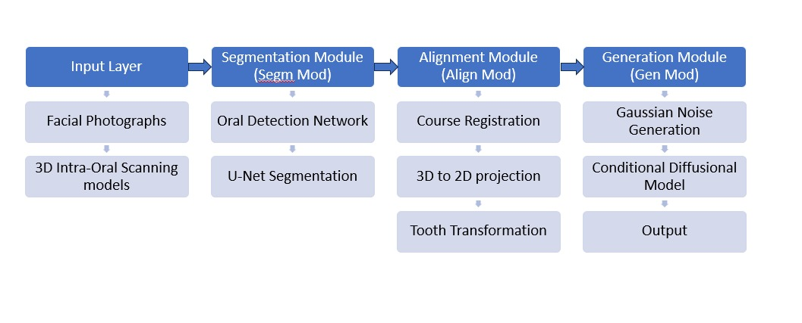
Orthodontic Treatment Simulation Working
Notes:
17

Slide 18
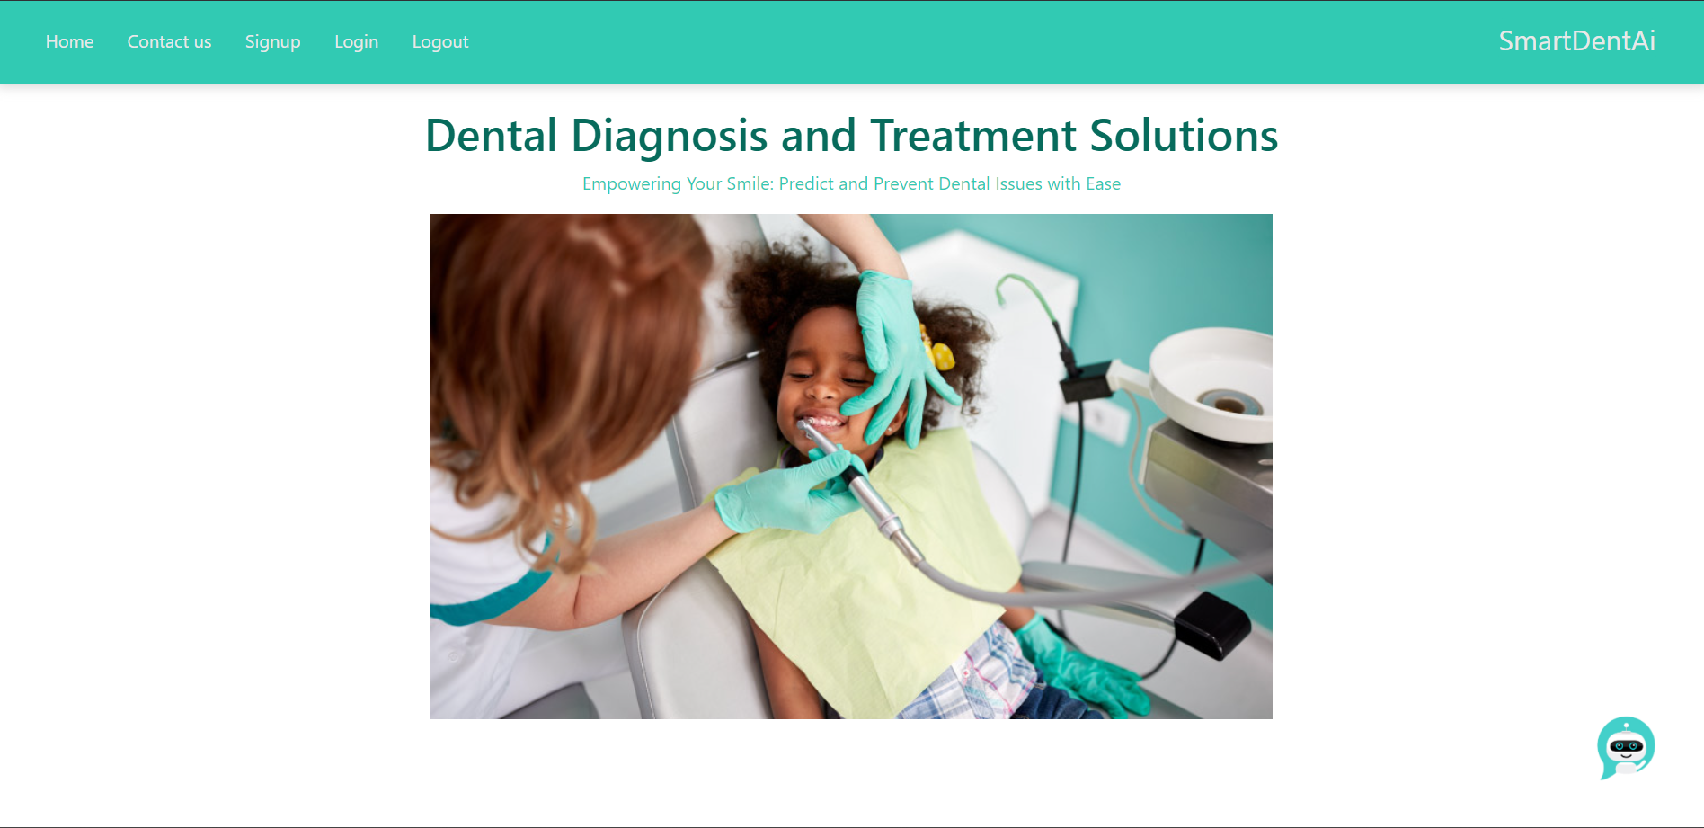
Implementation status

Slide 19
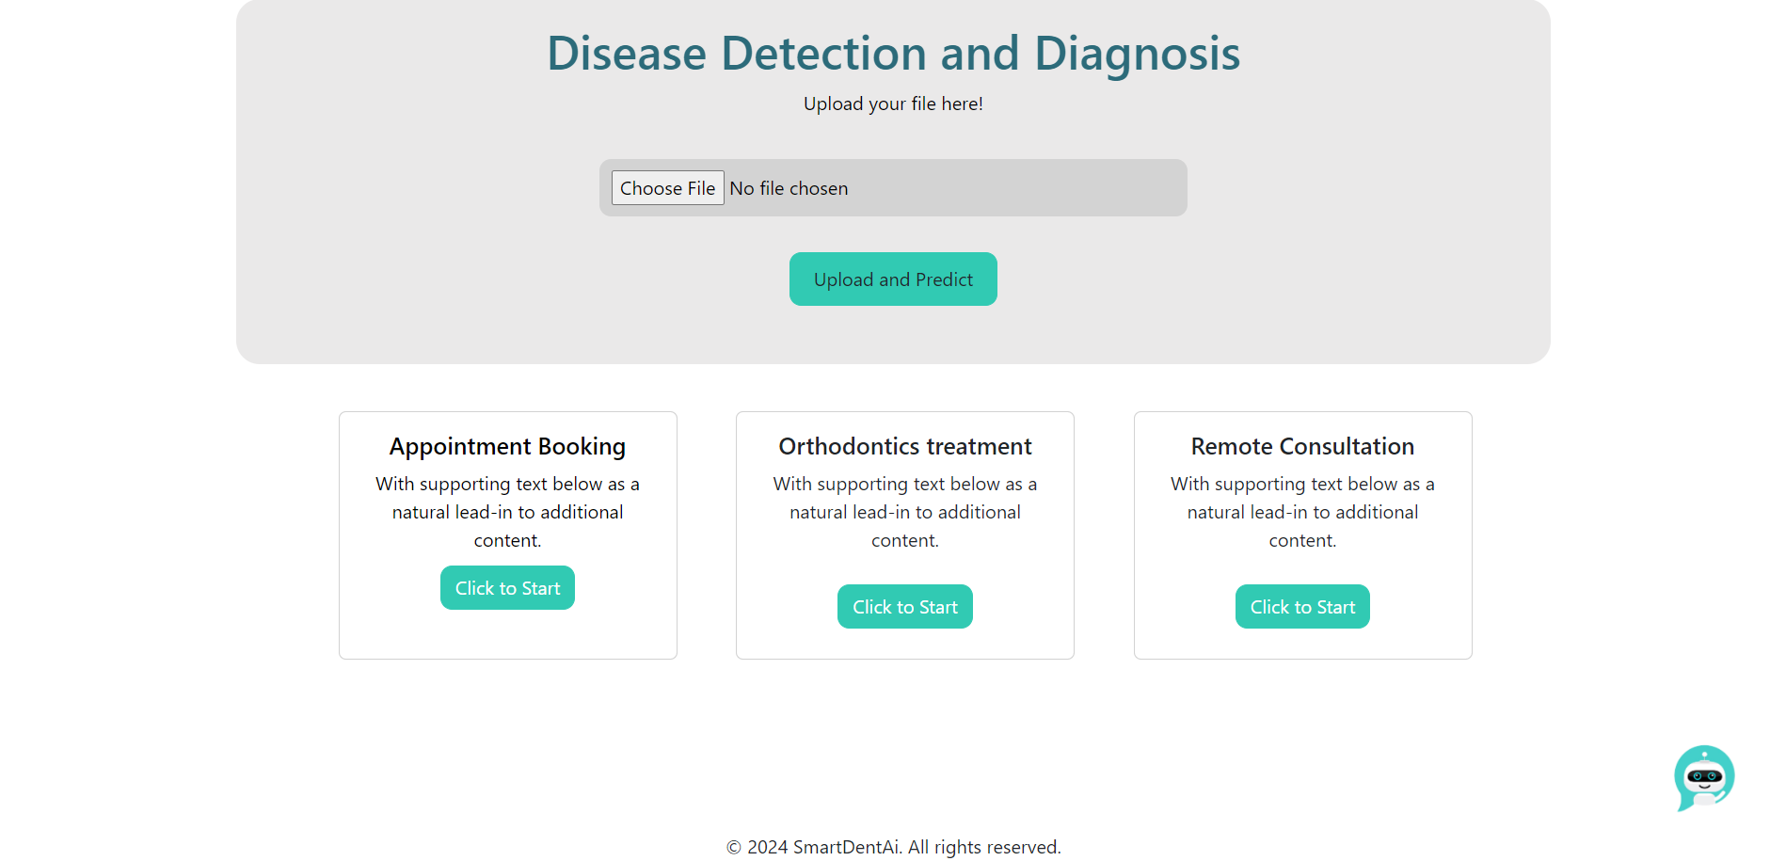

Slide 20
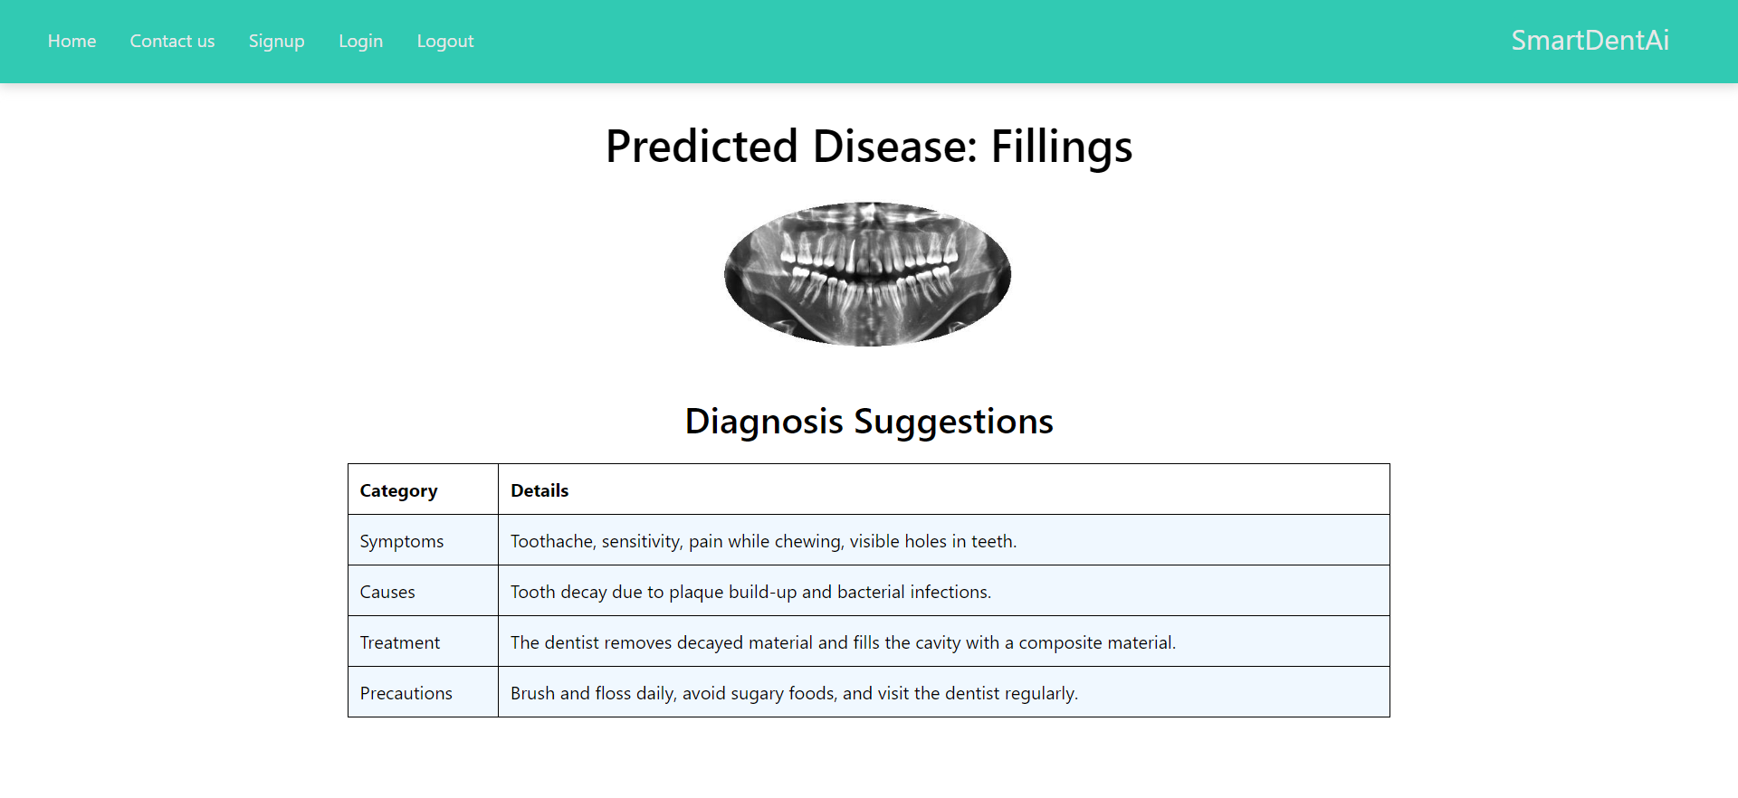

Slide 21
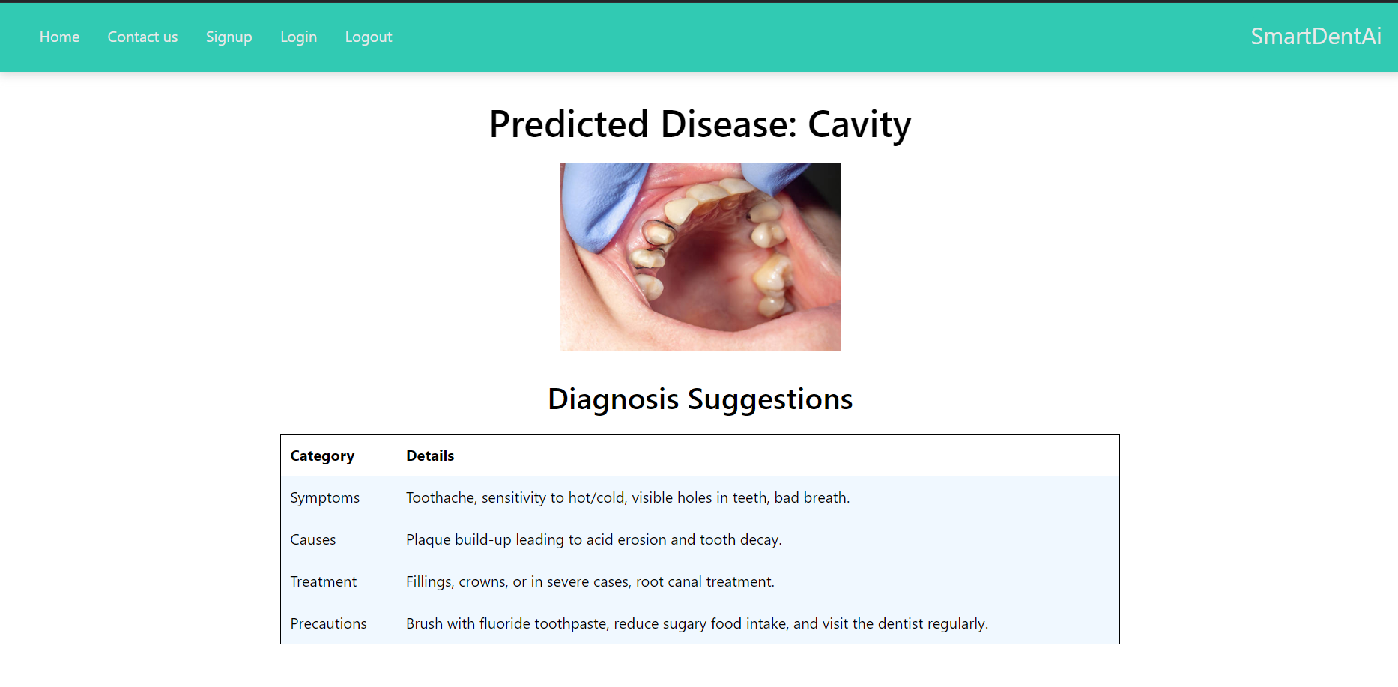

Slide 22
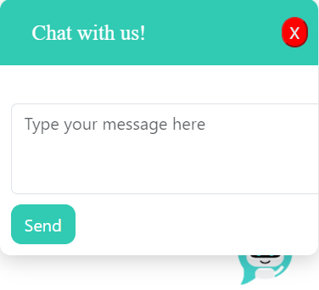

Slide 23
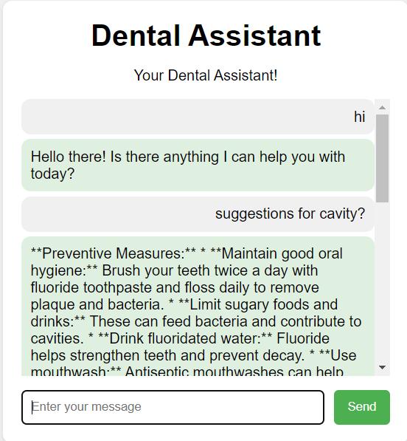

Slide 24
References
[1] Asmaul Hosna, Ethel Merry, Jigmey Gyalmo, Zulfikar Alom, Zeyar Aung, Mohammad Abdul Azim, "Transfer learning: a friendly introduction," Journal of Big Data, Pages 1-19, 2024.
https://journalofbigdata.springeropen.com/articles/10.1186/s40537-022-00652-w
[2] Haihua Zhu, Zheng Cao, Luya Lian, Guanchen Ye, Honghao Gao, Jian Wu, "CariesNet: a deep learning approach for segmentation of multi-stage caries lesion from oral panoramic X-ray image," Neural Computing and Applications, Volume 35, Pages 16051–16059, 2023.
https://link.springer.com/article/10.1007/s00521-021-06684-2
[3]​ S. Sivagami, P. Chitra, G. Sri Ram Kailash, S.R. Muralidharan, "UNet Architecture Based Dental Panoramic Image Segmentation," WiSPNET Conference Proceedings, Pages 187-191, 2020​.
https://ieeexplore.ieee.org/document/9198370
[4] Zhiyang Zheng, Hao Yan, Frank C. Setzer, Katherine J. Shi, Mel Mupparapu, Jing Li, "Anatomically Constrained Deep Learning for Automating Dental CBCT Segmentation and Lesion Detection," IEEE Transactions on Automation Science and Engineering, Pages 1-20, 2020​.
https://ieeexplore.ieee.org/document/9219218
Notes:
24

Slide 25
References
[5] Gautam Chitnis, Tejasvini Khadase, Vidhi Bhanushali, Vaishnavi Pelagade, Aayush Ranade, Jitendra Chavan, "A Review of Machine Learning Methodologies for Dental Disease Detection," IEEE India Council International Subsections Conference (INDISCON), Pages 1-10, 2020​.
https://ieeexplore.ieee.org/abstract/document/9344564
[6] Lawrence Y. Deng, See Sang Ho, Xiang Yann Lim, "Diseases Classification Utilizing Tooth X-ray Images Based on Convolutional Neural Network," 2020 International Symposium on Computer, Consumer and Control (IS3C), Pages 1-5, 2020​.
https://ieeexplore.ieee.org/document/9394023
[7] Dogun Kim, Jaeho Choi, Sangyoon Ahn, Eunil Park, "A smart home dental care system: integration of deep learning, image sensors, and mobile controller," Journal of Ambient Intelligence and Humanized Computing, Volume 12, Pages 1-17, 2021.
https://link.springer.com/article/10.1007/s12652-021-03366-8
[8] Raphael Patcas, Michael M. Bornstein, Marc A. Schätzle, Radu Timofte, "Artificial intelligence in medico-dental diagnostics of the face: a narrative review of opportunities and challenges," Clinical Oral Investigations, Volume 26, Pages 6871-6879, 2022.
https://pubmed.ncbi.nlm.nih.gov/36153437
Notes:
25

Slide 26
Thank You...!!
Notes:
26

